Slide 1
WEEK 4
Group Name Here

Slide 2
Introduction
In this week, we have started researching the diagrams needed for the Twitter crawler and visualization system. This system aims to collect data from Twitter using the Twitter API, and then analyze and visualize the collected data using Python libraries. The system will provide insights into Twitter users, their tweets, and their engagement levels.
To start with, we will be creating an Entity-Relationship Diagram (ERD) to model the system's data entities and their relationships. This will help us understand the system's data requirements and how the data should be organized in a database.
Once the ERD is finalized, we will be selecting a database to store the collected data. This will ensure that the data is organized, searchable, and can be easily accessed for further analysis and visualization.
Finally, we will be using Python libraries to crawl and collect data from Twitter's API, process and clean the data, and then visualize the data using graphs, charts, and other visualization techniques.
By the end of this week, we aim to have a clear understanding of the system's data requirements, a finalized ERD diagram, a selected database, and a plan for data crawling, processing, and visualization using Python.

Slide 3
DATABASE
Neo4j is a graph database management system that is designed to store, manage, and query graph data. In a graph database like Neo4j, data is stored as nodes and edges, where nodes represent entities, and edges represent the relationships between these entities.
Neo4j is particularly well-suited for applications that involve complex and highly connected data, such as social networks, recommendation systems, and knowledge graphs. In the case of our Twitter crawler and visualization system, we can use Neo4j to store the data entities (e.g., Twitter users, tweets, hashtags, etc.) as nodes, and the relationships between these entities (e.g., who follows whom, who has tweeted what, etc.) as edges.
Using Neo4j, we can easily query the data and perform complex graph analysis to identify patterns, clusters, and communities within the data. We can also use Neo4j's built-in algorithms and visualization tools to create interactive visualizations that allow us to explore and understand the data.
To use Neo4j with Python, we can use the py2neo library, which provides a Python interface to Neo4j's REST API. We can use py2neo to connect to a Neo4j database, create and modify nodes and edges, and perform graph queries and analysis.

Slide 4
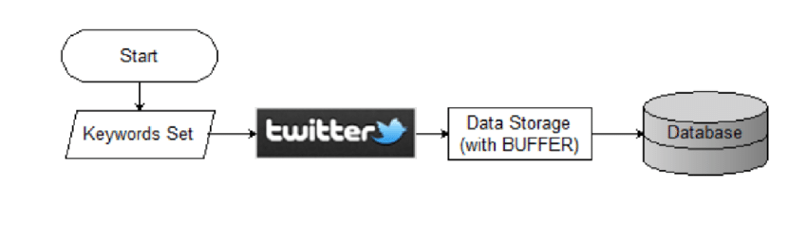
Twitter Crawling Flow

Slide 5
Prerequisites
Knowledge of Python programming: You should have a good understanding of Python programming language and syntax, including how to install and use Python libraries.
Twitter Developer Account: You need to have a valid Twitter account and apply for a Twitter Developer Account to access Twitter's API.
Twitter API Keys: You need to create a Twitter App and obtain API keys to access the Twitter API.
Python Libraries: You need to have the following Python libraries installed: tweepy, pandas, and matplotlib.
Integrated Development Environment (IDE): You should have a Python IDE installed on your computer, such as Visual Studio Code, PyCharm, or Spyder.
Data Analysis Concepts: Basic understanding of data analysis concepts such as data cleaning, data preprocessing, and data visualization is recommended.

Slide 6
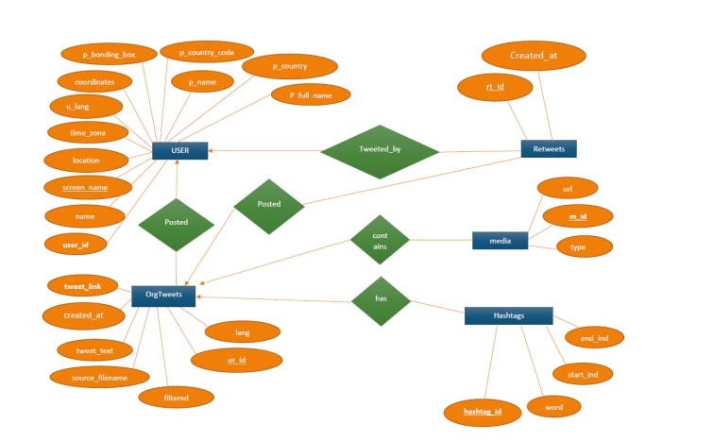
ER Diagram

Slide 7
Further works
Next steps for your Twitter crawler and visualization project:
Data collection: Refine your data collection process to ensure that you are collecting the most relevant and useful data. This might involve using more specific search terms or filtering out irrelevant data.
Data processing and cleaning: Improve the data processing and cleaning steps to ensure that the data is accurate, consistent, and free of errors. This might involve using more advanced text processing techniques or incorporating machine learning algorithms to classify or cluster the data.
Data storage: Consider scaling up your data storage solution to accommodate larger volumes of data. You may need to migrate to a more powerful database engine or implement a distributed data storage solution.
Data analysis and visualization: Use more advanced techniques and tools to perform deeper analysis of the data and create more sophisticated visualizations. This might involve using machine learning algorithms to identify patterns or anomalies in the data, or creating interactive visualizations using web-based frameworks like D3.js.
Integration with other systems: Consider integrating your Twitter crawler and visualization system with other systems or platforms. For example, you could integrate with a web application to allow users to interact with the data in real-time, or with a marketing automation platform to provide insights into social media engagement metrics.
Deployment and maintenance: Ensure that your system is deployed and maintained properly to ensure ongoing stability and performance. This might involve setting up automated monitoring and alerting, or implementing automated testing and deployment pipelines.

Slide 8
Conclusion
In conclusion, our Twitter crawler and visualization project aims to collect data from Twitter using the Twitter API, store and organize the data in a graph database like Neo4j, and analyze and visualize the data using Python libraries.
We started by researching the diagrams needed for the system and created an Entity-Relationship Diagram (ERD) to model the system's data entities and their relationships. We then selected Neo4j as the database to store the collected data, given its ability to store and query graph data.
Moving forward, we plan to refine our data collection process, improve our data processing and cleaning steps, consider scaling up our data storage solution, use more advanced techniques and tools for data analysis and visualization, integrate with other systems, and ensure proper deployment and maintenance of the system.
Overall, this project aims to provide insights into Twitter users, their tweets, and their engagement levels, and enable more effective social media marketing and analysis.

Slide 9
References
Twitter API documentation: https://developer.twitter.com/en/docs
py2neo documentation: https://py2neo.org/v4/
Neo4j documentation: https://neo4j.com/docs/
D3.js documentation: https://d3js.org/
"Mining the Social Web" book by Matthew A. Russell: http://shop.oreilly.com/product/0636920030195.do
"Python for Data Analysis" book by Wes McKinney: https://www.oreilly.com/library/view/python-for-data/9781491957653/
"Python Data Science Handbook" by Jake VanderPlas: https://jakevdp.github.io/PythonDataScienceHandbook/
"Data Science from Scratch" book by Joel Grus: https://www.oreilly.com/library/view/data-science-from/9781492041122/
"Hands-On Data Science for Marketing" book by Yoon Hyup Hwang and Sinan Ozdemir: https://www.packtpub.com/product/hands-on-data-science-for-marketing/9781800202089

